Slide 1
{.cloister}
AZTEC GAME LABS ltg PLOT PITCH

Slide 2
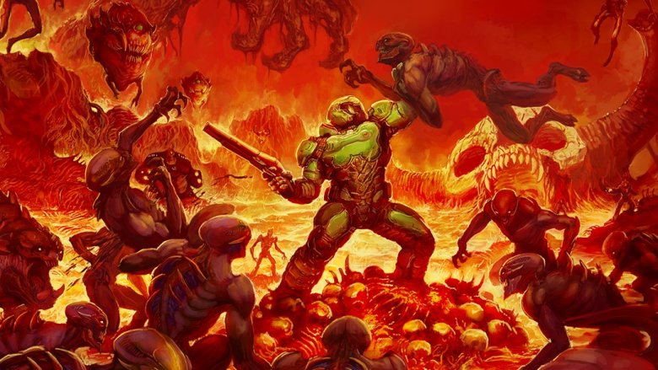
Oh Shit. It’s Demons.
Set in the near future, after a cataclysmic war with demons that climbed up out of the earth.
Unexpectedly, the demons had their own weird technology that they used to steal people’s souls.
Humanity fought back by stealing this tech, and using it against them.

Slide 3
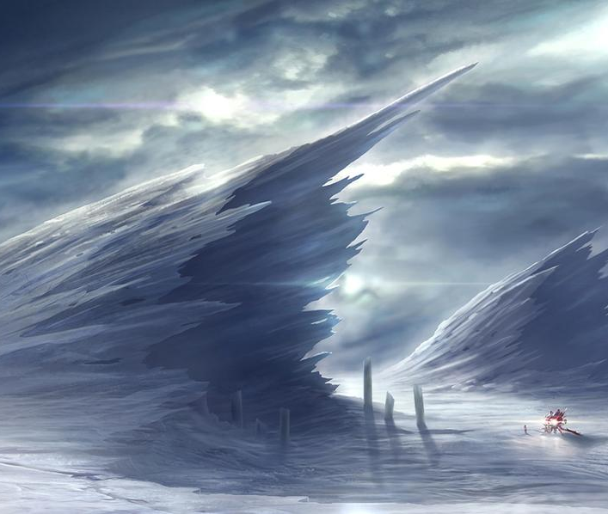
Victory?
The Cocytus Bomb: A demon-derived weapon used to freeze the Earth.
Two methods of escape:
The Space Station ‘Purgatory’
The Cloisters
The plan:
Render the Earth uninhabitable, killing all demons.
Hackers from ‘Purgatory’ activate the Cloisters, and re-seed the Earth.
Resurrect the digitized souls of humanity.

Slide 4
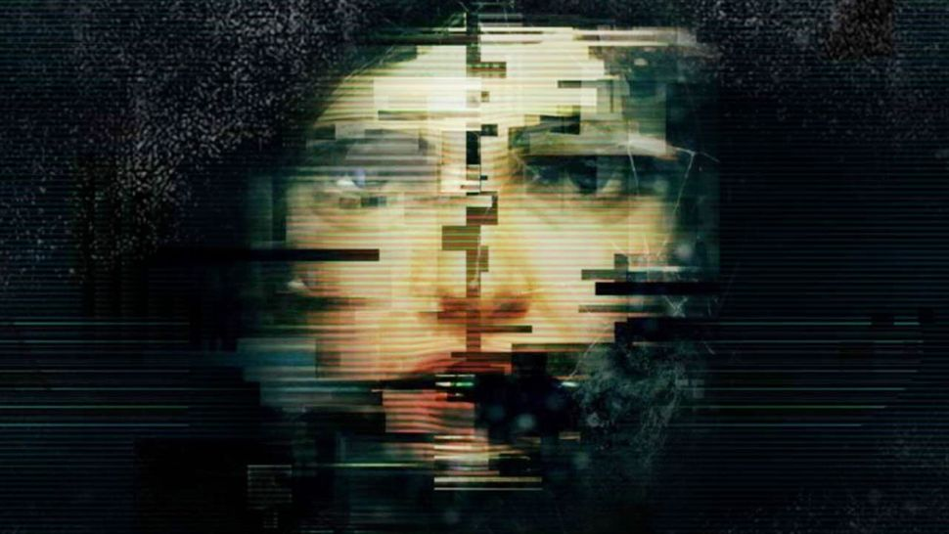
The Big Problem
Despite security measures, the demons have somehow infiltrated the virtual worlds of the Cloisters.
They’ve corrupted the environment and left the digitized souls of the inhabitants in a living glitchy cyber-hell.
As a Hacker from the satellite, you have to decode the co-opted security of the Cloisters to activate them before there’s nothing left to resurrect.
Corrupted souls and viral demons will attempt to stop you.
But… things might not be that simple.

Slide 5
Questions? Thoughts?

